Slide 1
COM682 Cloud Native Development Coursework 2
Social media sharing platform
David Fodor B00796884

Slide 2
Problem Definition and Discussion
A social media sharing platform requires storage that is ever-growing, as more and more content is shared on it.
An on-premises setup offers finite storage, it has to be paid for upfront, and has to be maintained (Torres-Corral, 2021).
A cloud setup can be scaled easily on demand, thus removing the possibility of resources that are not taken advantage of, or the possibility of resources not being enough. It usually has a subscription model, so costs do not need to be paid upfront.
Setting up a Web App in Azure also offloads maintenance tasks and removes the burden of server administration from the client (Listek, 2021).

Slide 3
Problem Definition and Discussion
Three major models of cloud architecture:
Infrastructure as a Service (IaaS): A third-party provider of servers, networks and storage, paid for by the end user depending on the capacity they need at any given time. - This is Microsoft Azure in our case (Bernazzani, 2021).
Platform as a Service (PaaS): Delivery of a computing platform for the end user to configure and deploy an application which is hosted there. Includes infrastructure, but also middleware like development tools and database management (Microsoft, 2022). – This is also done through Microsoft Azure in our case.
Software as a Service (SaaS): Delivery and maintenance of applications over the Internet, to be accessed via a web interface. – This is the social media sharing platform in our case.

Slide 4
Overview of the technical solution developed
For the task of implementing a social media sharing platform in Azure, the most obvious solution was to make a WordPress site as an App Service (the IT videos, 2021).
A MYSQL database was created for the App Service.
The created App Service is scalable through choosing between different App Service plans for different prices (Microsoft, 2022).
WordPress has some free plugins available such as BuddyPress (Buddypress, 2022) and rtMedia (rtCamp, 2022), for the purpose of making a social media website and sharing media.

Slide 5
Overview of the technical solution developed
An alternative to Cloud is an On-Premises setup, with choosing a domain name and an option for web hosting. Since scalability requires us to use Cloud, this option was disregarded.
There are social network PHP scripts available, such as WoWonder (WoWonder, 2022). One of these could have been an alternative to using a WordPress site, however, they can cost hundreds of dollars, and they are more difficult to set up.
There are premium social media plugins available for WordPress, such as PeepSo (PeepSo, 2022) or BuddyBoss (BuddyBoss, 2022). They are more sophisticated than BuddyPress, but they are not free.

Slide 6
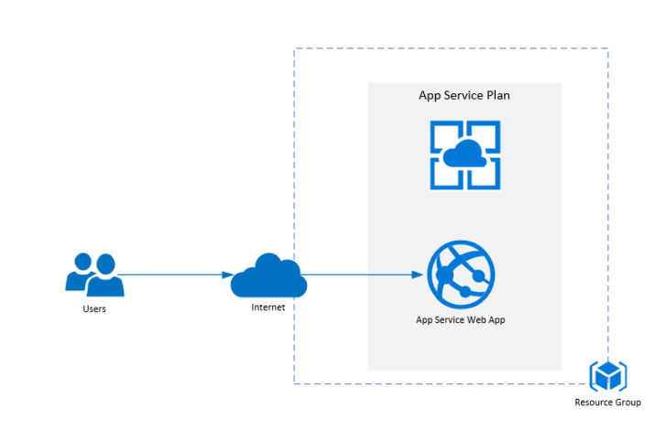
Overview of the technical solution developed
Here is an architecture diagram (Jana, 2020) which is applicable to this scenario. The WordPress site is the App Service Web App on the diagram.

Slide 7
Assessment of Limitations and Scalability
The Azure for Students subscription was used for hosting and deploying the app, which provides $100 Azure credit.
Upscaling the App Service would come with additional costs.
Without additional spending, the App Service is quite slow.
The Azure for Students subscription expires after 12 months, a subscription upgrade is necessary if the app is still needed after that time period.

Slide 8
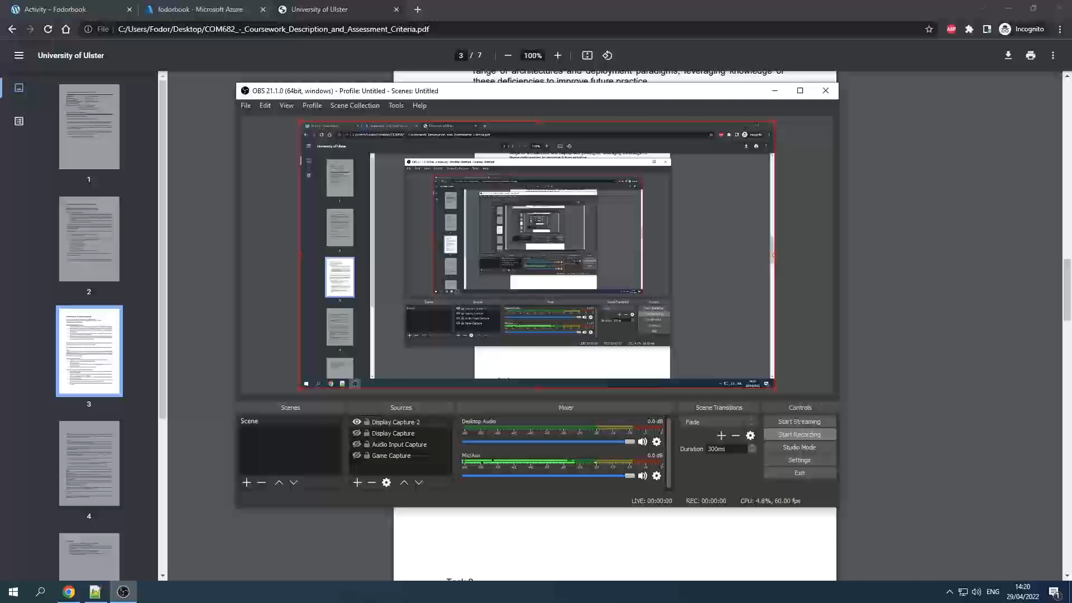
Functionality of the recorded demonstration

Slide 9
Concluding comments
The developed social media sharing platform is technically capable of performing the basic tasks which were laid out in the assignment specification.
Without additional spending on upscaling, the web app is slow.
If this platform was to be released to the public in a professional capacity, a more sophisticated layout design would be needed to properly communicate a corporate identity. This would involve writing custom CSS code for the website.
Additional features could be added to the website by making custom plugins, or paying for existing ones.

Slide 10
References
Torres-Corral, A. (2021). On-Premises vs. Cloud: What’s the Difference? [online] Available at: https://www.alertlogic.com/blog/on-premises-vs-cloud-whats-the-difference [Accessed 29 Apr. 2022].
Listek, A. (2021). How to Set Up a WordPress Blog in Microsoft Azure [online] Available at: https://adamtheautomator.com/azure-wordpress [Accessed 22 Apr. 2022].
Bernazzani, S. (2021). IaaS vs. PaaS vs. SaaS: Here's What You Need to Know About Each [online] Available at: https://blog.hubspot.com/service/iaas-paas-saas [Accessed 29 Apr. 2022].
Microsoft. (2022). What is PaaS? [online] Available at: https://azure.microsoft.com/en-in/overview/what-is-paas [Accessed 29 Apr. 2022].
Microsoft. (2021). Azure App Service plan overview [online] Available at: https://docs.microsoft.com/en-us/azure/app-service/overview-hosting-plans [Accessed 29 Apr. 2022].
The IT videos. (2021). How to create Wordpress site in Azure Step by Step [online] Available at: https://www.youtube.com/watch?v=znct7ANPQ7g [Accessed 22 Apr. 2022].
BuddyPress.org. (2022). About | BuddyPress.org [online] Available at: https://buddypress.org/about [Accessed 22 Apr. 2022].
rtCamp. (2022). rtMedia for WordPress, BuddyPress & bbPress [online] Available at: https://rtmedia.io [Accessed 22 Apr. 2022].
WoWonder. (2022). WoWonder – The Ultimate PHP Social Network Platform [online] Available at: https://www.wowonder.com [Accessed 23 Apr. 2022].
PeepSo. (2022). Free User Profile and Community WordPress Plugin | PeepSo [online] Available at: https://www.peepso.com [Accessed 23 Apr. 2022].
Boss Media Ltd. (2022). Build online communities, sell courses & memberships on WordPress [online] Available at: https://www.buddyboss.com [Accessed 23 Apr. 2022].
Jana, A. (2020). 10 Azure Cloud services that every Developers, Consultant, and Architects should Know and Learn it well [online] Available at: https://abhijitjana.net/2020/04/18/10-azure-cloud-services-that-every-developers-consultant-and-architects-should-know-and-learn-it-well [Accessed 29 Apr. 2022].

